Slide 1


CS3003: Logic / Declarative Programming

Slide 2
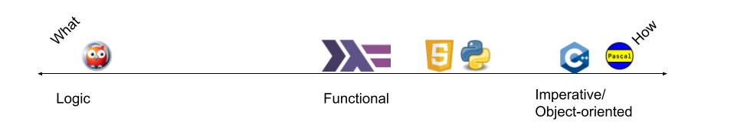
What How Continuum

Slide 3
Prolog program components
Facts
Rules
Queries

Slide 4
Syntactic elements in Prolog
Atoms: The most fundamental unit of a Prolog program. They are simply symbols. Usually they are simply sequences of characters that begin with a lowercase letter. However, atoms can contain spaces (in which case they are enclosed in 's) and they can start with uppercase letters (in which case they are wrapped with 's).
Variables: Like atoms, but variables always start with uppercase letters.
Functors: Like atoms, but functors define relationships/facts.

Slide 5
Example facts
takes(jane, cs4999).
takes(alicia, cs2020).
takes(alice, cs4000).
takes(mary, cs1021).
takes(bob, cs1021)..

Slide 6
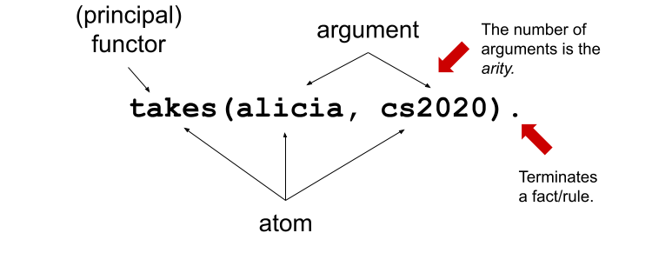
Syntactic elements in Prolog

Slide 7
Is this the same?
tennis_shoes(jane, cs4999).
tennis_shoes(alicia, cs2020).
tennis_shoes(alice, cs4000).
tennis_shoes(mary, cs1021).
tennis_shoes(bob, cs1021)..

Slide 8
Lets try it out

Slide 9
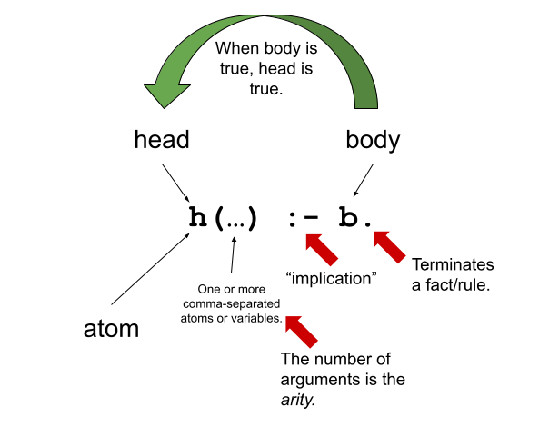
Format of a rule

Slide 10
Backtracking
backtracking: Search process used by Prolog. If a predicate offers multiple clauses to solve a goal, they are tried one-by-one until one succeeds. If a subsequent part of the proof is not satisfied with the resulting variable binding, it may ask for an alternative solution, causing Prolog to reject the previously chosen clause and try the next one.

Slide 11
Choice points
A choice point represents a choice in the search for a solution. Choice points are created if multiple clauses match a query or using disjunction (;/2). On backtracking, the execution state of the most recent choice point is restored and search continues with the next alternative (i.e., next clause or second branch of ;/2).

Slide 12
Example

Slide 13
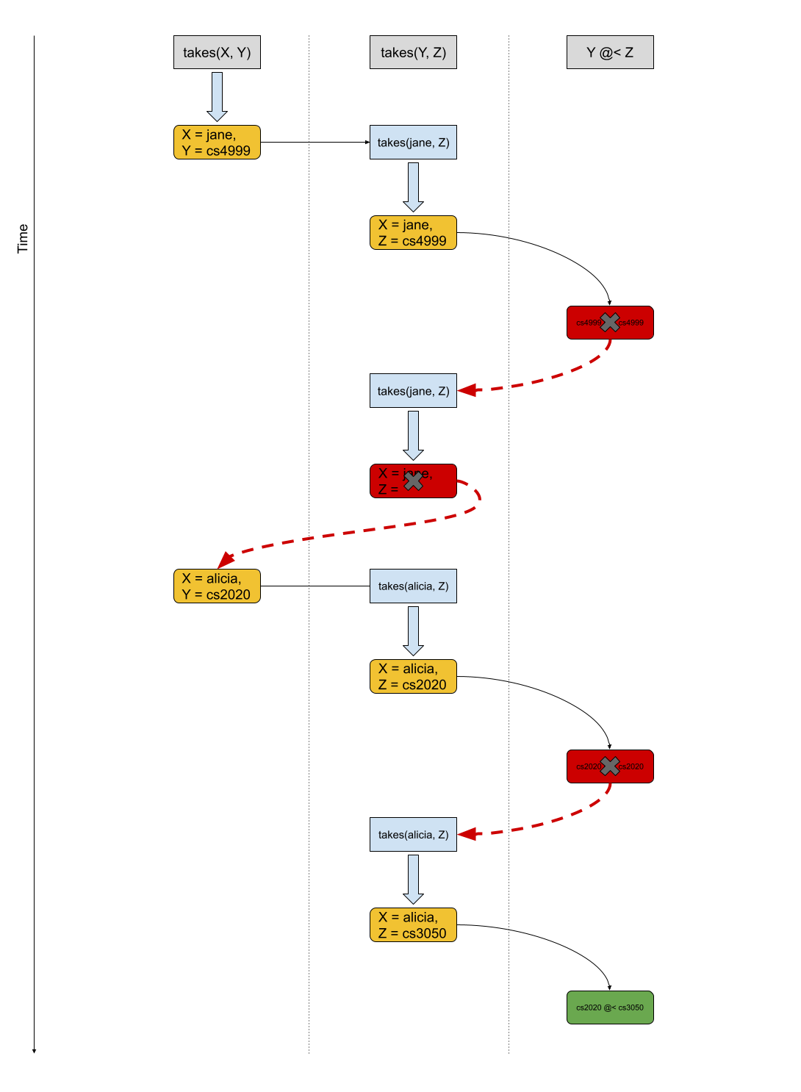
Visualization

Slide 14
Generating Integers

Slide 15
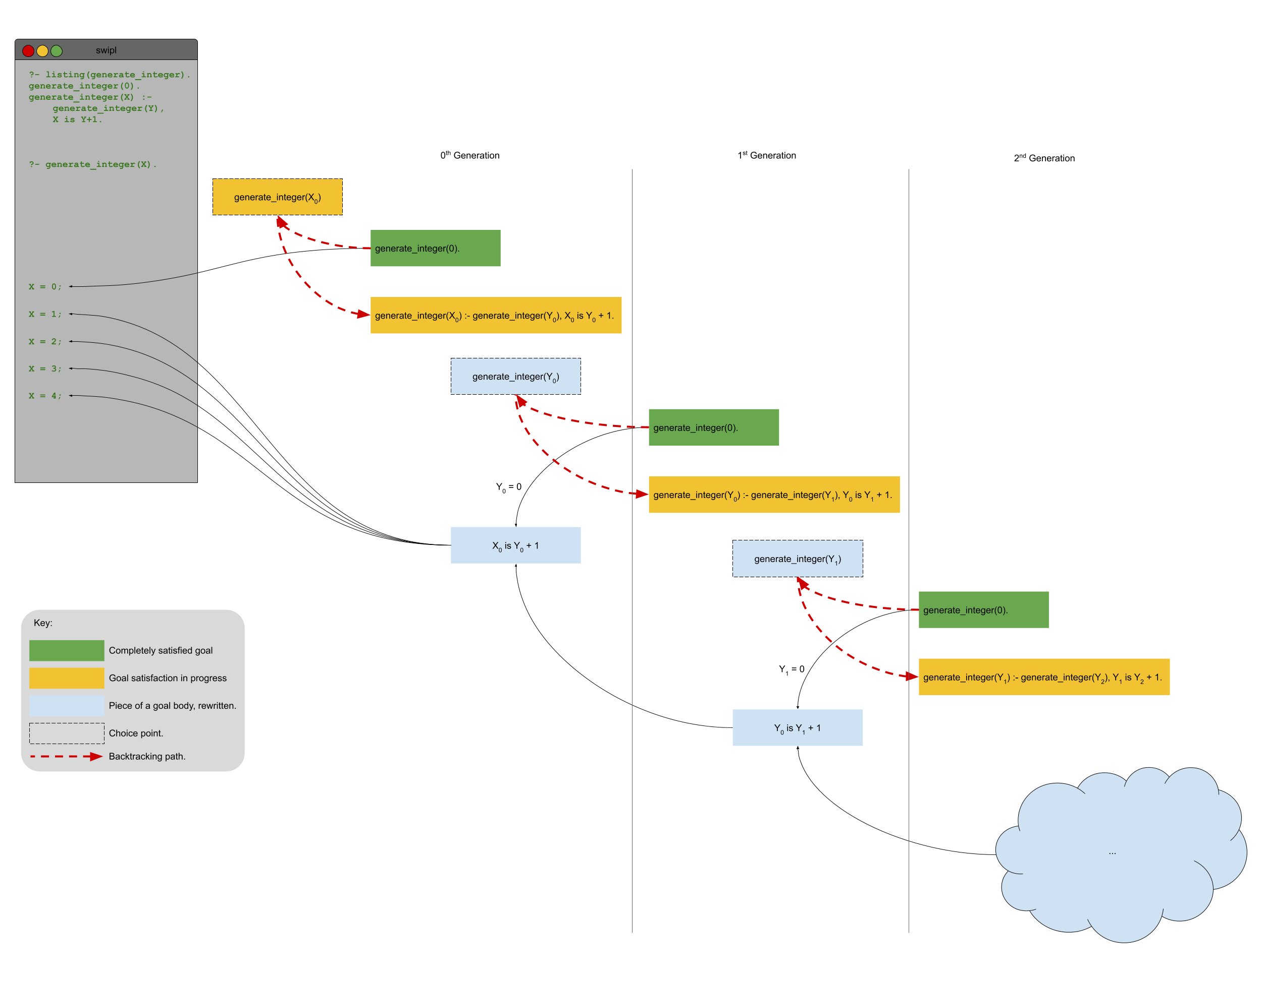
Generating Integers

Slide 16
Generating Integers – Tail Recursion

